Slide 1
Ethernet LANs
Exploring the Packet Delivery Process

Slide 2
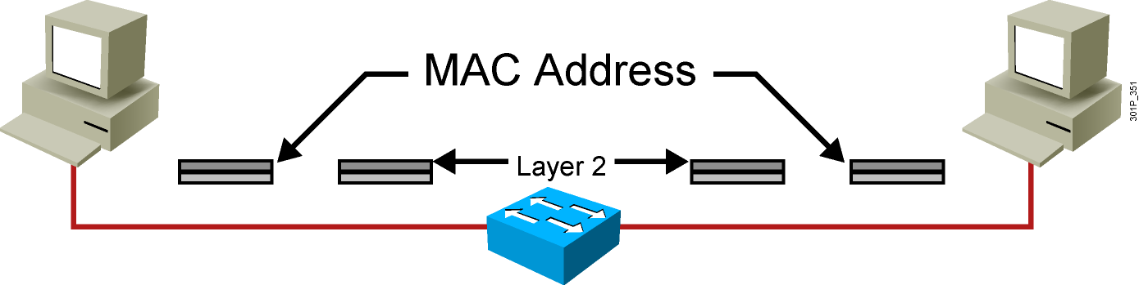
Layer 2 Addressing
  Uses MAC address
  Assigned to end devices
Notes:
Lesson Aim
<Enter lesson aim here.>

Slide 3

Layer 3 Addressing
  Each NOS has its own Layer 3 address format.
  OSI uses NSAP.
  TCP/IP uses IP.
Notes:
Lesson Aim
<Enter lesson aim here.>

Slide 4
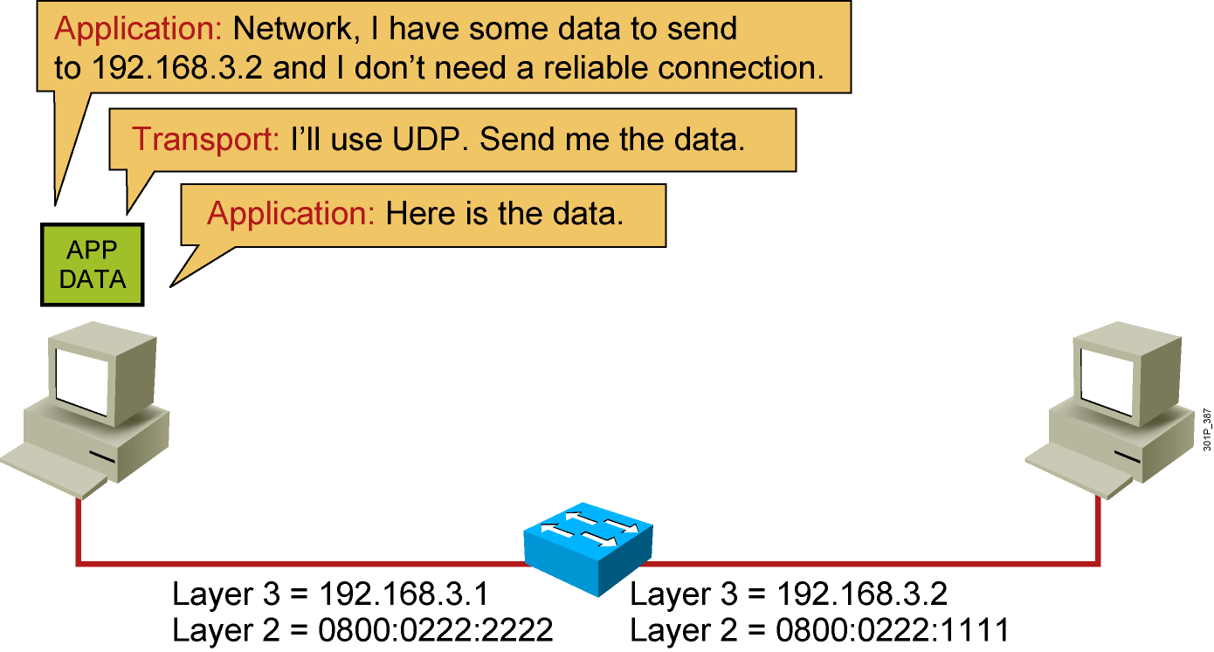
Host-to-Host Packet Delivery (1 of 10)
Notes:
Lesson Aim
<Enter lesson aim here.>

Slide 5
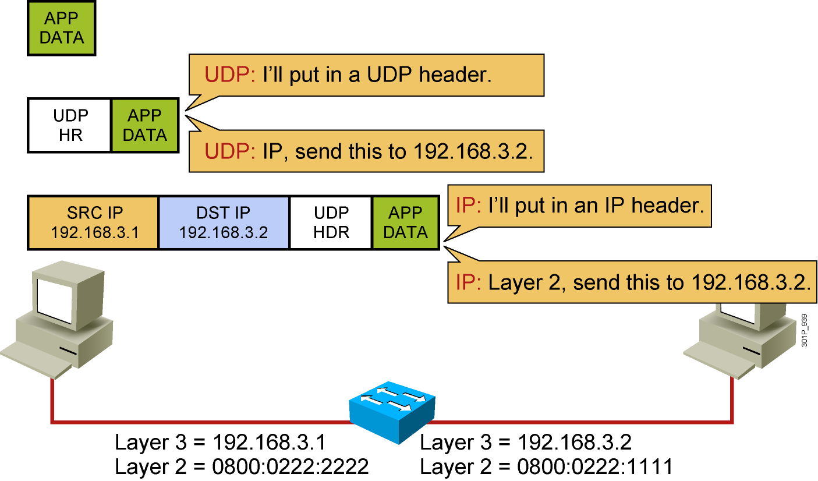
Host-to-Host Packet Delivery (2 of 10)
Notes:
Lesson Aim
<Enter lesson aim here.>

Slide 6
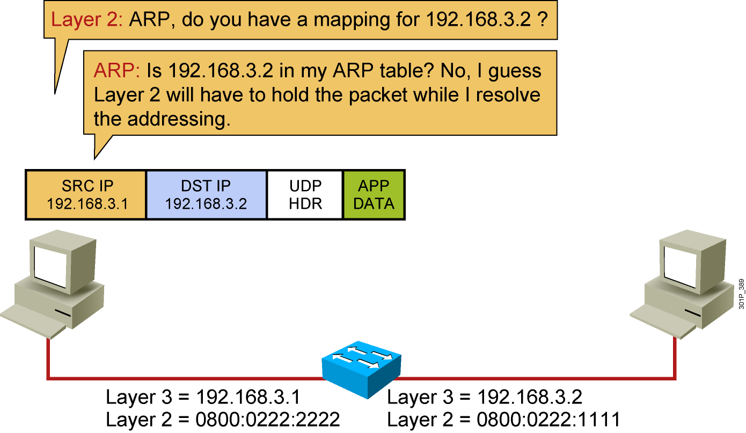
Host-to-Host Packet Delivery (3 of 10)
Notes:
Lesson Aim
<Enter lesson aim here.>

Slide 7
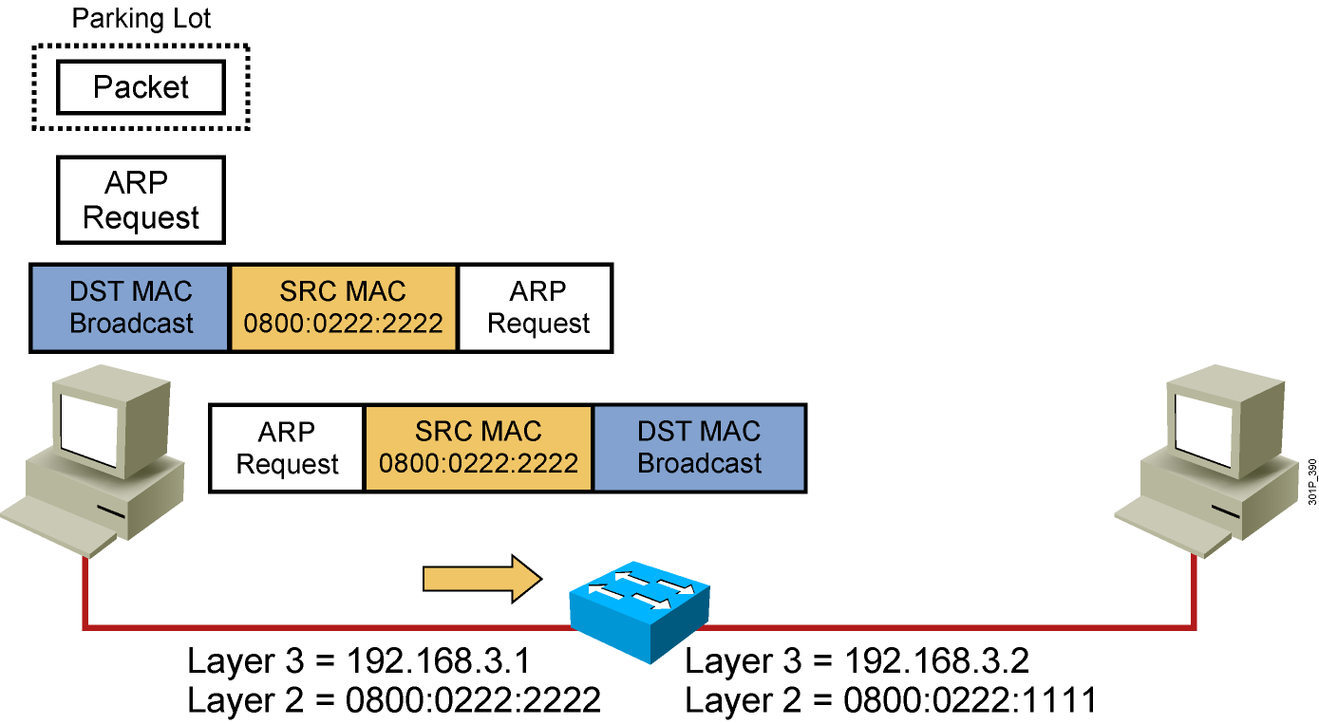
Host-to-Host Packet Delivery (4 of 10)
Notes:
Lesson Aim
<Enter lesson aim here.>

Slide 8
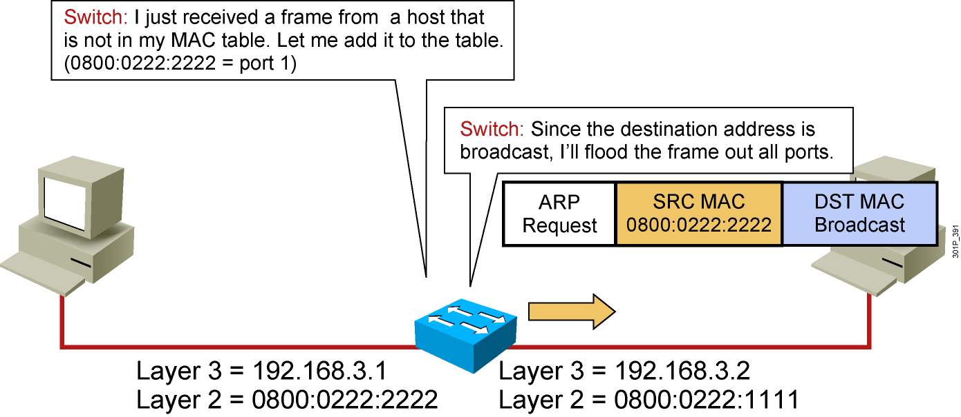
Host-to-Host Packet Delivery (5 of 10)
Notes:
Lesson Aim
<Enter lesson aim here.>

Slide 9
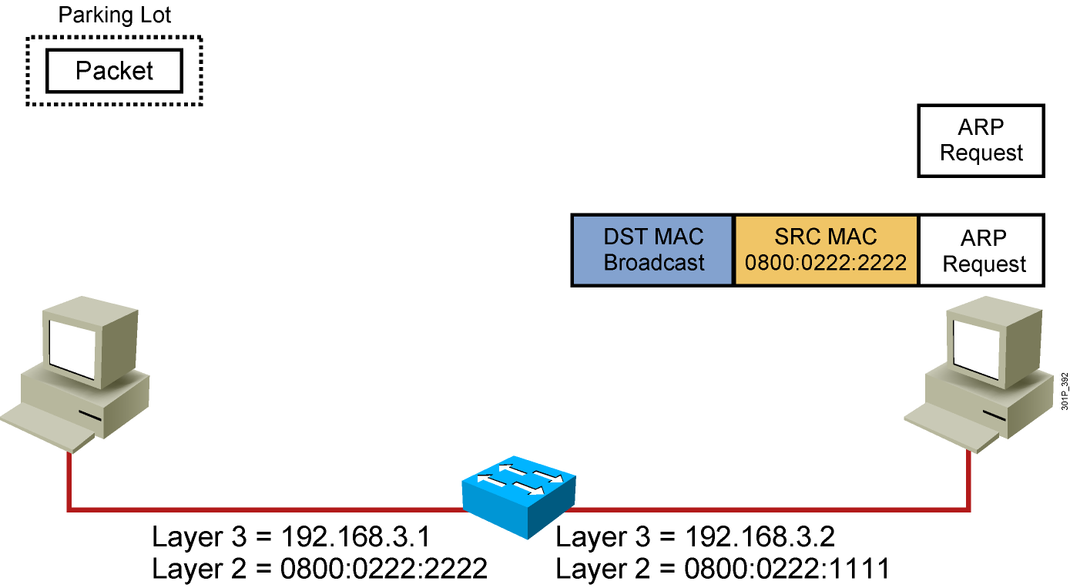
Host-to-Host Packet Delivery (6 of 10)
Notes:
Lesson Aim
<Enter lesson aim here.>

Slide 10
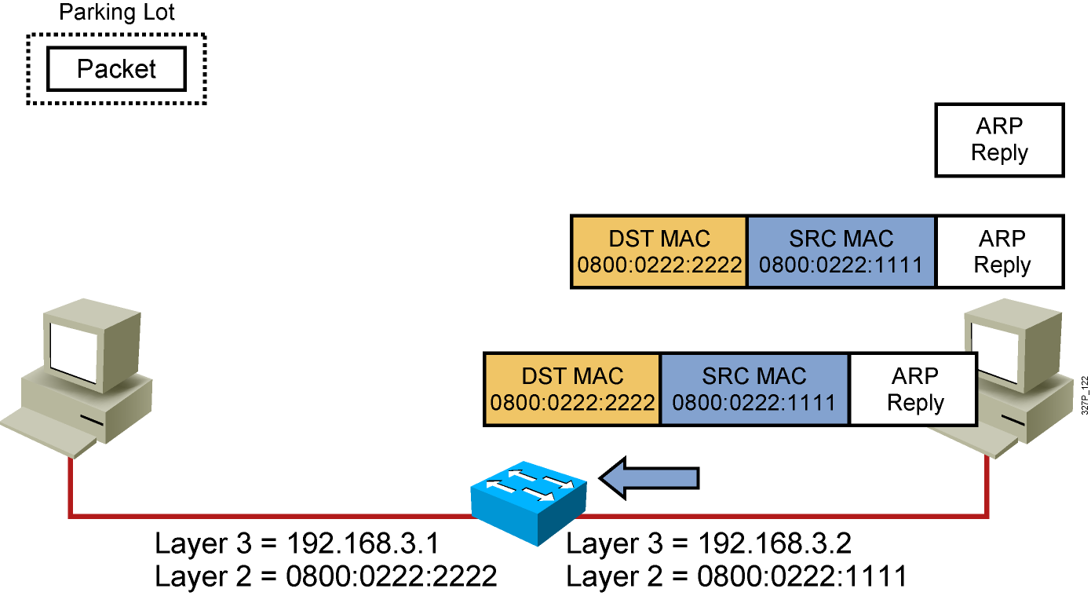
Host-to-Host Packet Delivery (7 of 10)
Notes:
Lesson Aim
<Enter lesson aim here.>

Slide 11
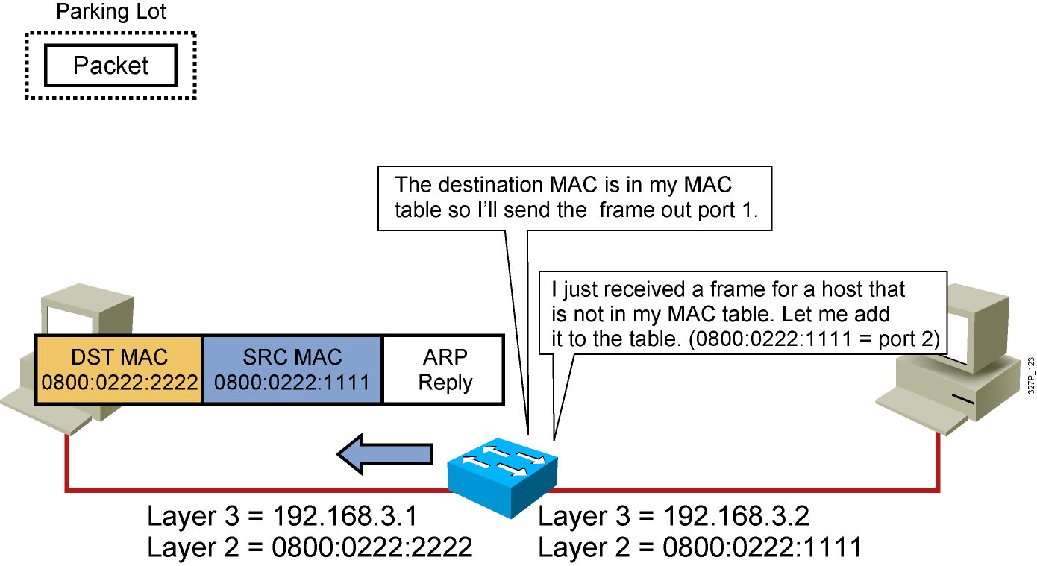
Host-to-Host Packet Delivery (8 of 10)
Notes:
Lesson Aim
<Enter lesson aim here.>

Slide 12
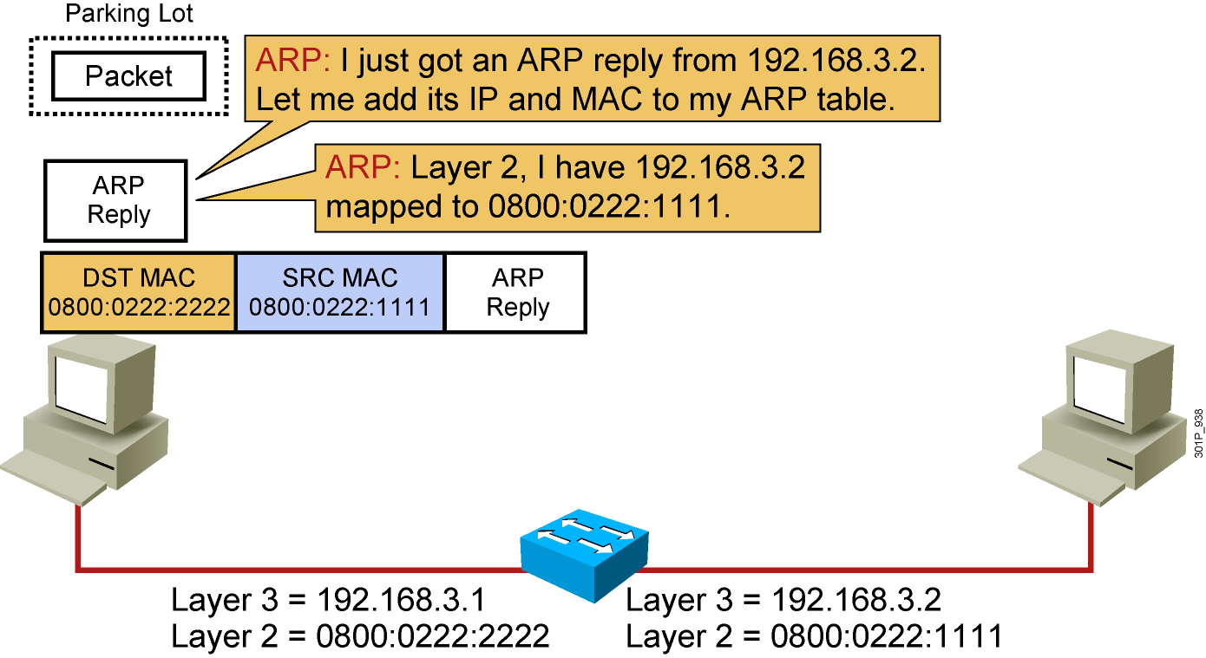
Host-to-Host Packet Delivery (9 of 10)
Notes:
Lesson Aim
<Enter lesson aim here.>

Slide 13
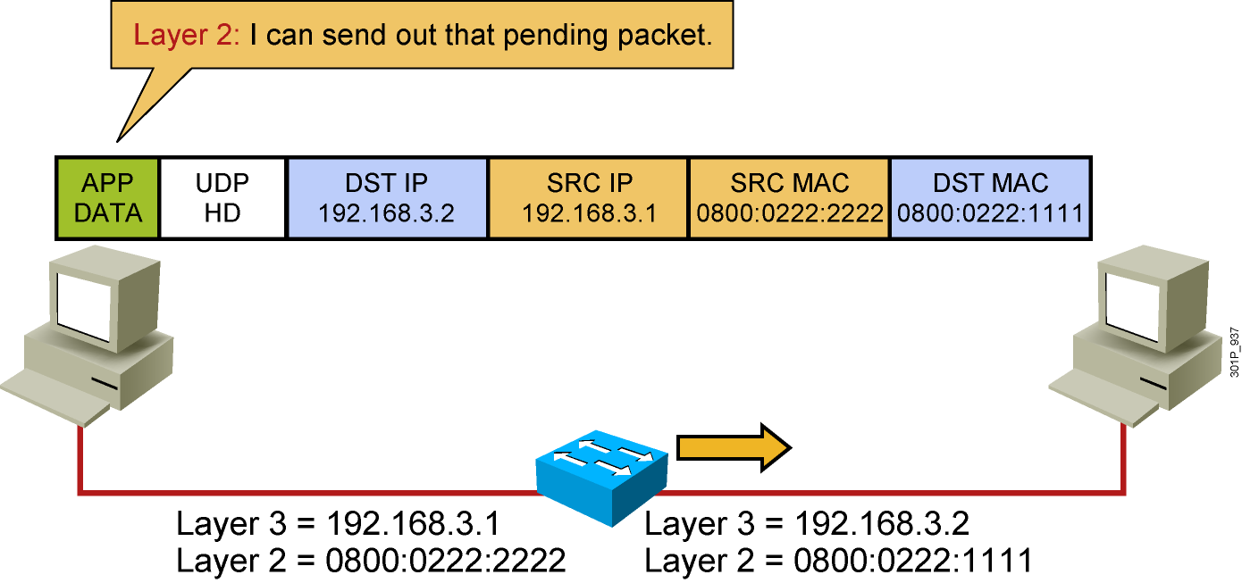
Host-to-Host Packet Delivery (10 of 10)
Notes:
Lesson Aim
<Enter lesson aim here.>

Slide 14
Summary
  Layer 2 addresses are MAC addresses.
  Layer 3 addresses are IP addresses.
  If the MAC address is not known, ARP is used to map Layer 2 to Layer 3.
  Switches learn the MAC addressing to port mapping by monitoring the source addresses of frames.
  When a switch forwards a frame, it does not change the source or destination Layer 2 address.

